Slide 1

Math Quiz App
An Interactive Learning Tool for Math Enthusiasts
Avishay Elrom

Slide 2

Introduction
Our Purpose:
The Math Quiz App is designed to enhance mathematical skills through an interactive and engaging platform.
Targeted at students, educators, parents, and
math enthusiasts.

Slide 3

Key Features of the MathQuiz App
Interactive Quiz with instant feedback.
Profile Management for personalized experiences.
User-friendly navigation and interface.

Slide 4
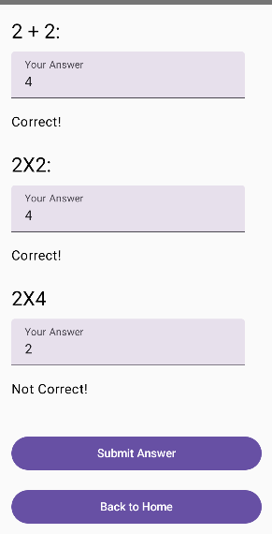
Feature 1
Interactive Quiz with instant feedback.

Slide 5
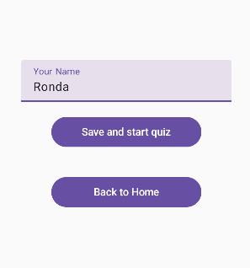
Feature 2
Profile Management for personalized experiences:
As we puts our name under “Your Name” Tab and press “save and start Quiz” the App start the quiz under the profile name .

Slide 6
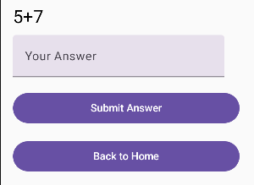
Feature 3
User-friendly navigation and interface: simple navigation and simple interface , as soon as we press save and start quiz we get to navigate to the QuizScreen and gets to start the quiz . Therefor we can also back to home screen in any time.

Slide 7
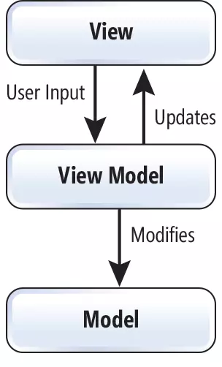
Technical Overview
Built using Kotlin and Jetpack Compose.
Follows the MVVM architecture for better code management and scalability.
Key components: ‘MainActivity’, ‘NavGraph’, ‘QuizScreen’ , ‘ProfileScreen’, ‘QuizViewModel’

Slide 8
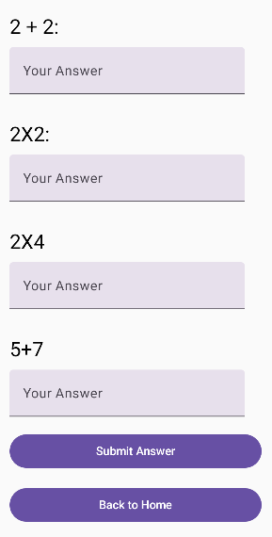
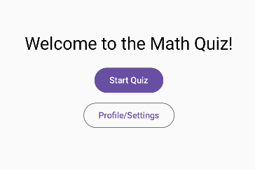
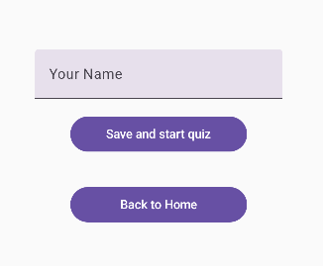
Walkthrough of Key Features
QuizScreen:
HomeScreen:
1.Home Screen: Starting point of the app with options to start a quiz or edit profile.
2. Profile Screen: Allows users to set their profile and personalize their experience.
3.Quiz Screen: Displays dynamic questions, collects user answers, and provides feedback.
ProfileScreen:

Slide 9

Educational Impact
Reinforces learning through practice and immediate feedback.
Helps identify areas of strength and weakness.
Suitable for use in educational settings as a learning aid.

Slide 10
Innovative Elements
Dynamic question generation ensures a new experience each time.
Instant feedback feature helps users learn and correct mistakes on the go.
Simple and intuitive design makes it accessible to all age groups.

Slide 11

Conclusion and Future Work
Summarize the app’s benefits and its impact on learning.
Mention potential future enhancements
(e.g., adding different difficulty levels, more question types, multiplayer mode).

Slide 12

Questions & Answers
Invite questions from the audience to clarify any doubts or discuss further enhancements.

